Slide 2
EIP
A Brief Introduction

Slide 3

WHAT IS IT ALL ABOUT?
Integration
EIP
Platform
Tools
Frameworks
Notes:
Integration can be a number of things:
Offering web services to external clients (mobile apps)
connecting large business applications, (ica) / (Pensionsmyndigh.) / (MM Bank AB) / (Inera)
Connecting several internal and external services to create a payment-switch for PoS (coop)
EIP Will discuss tomorrow
Platform helps with all the generic parts: infra / arch / boilerplate etc.
Tools to make life easy.
Frameworks to make lite even easier.

Slide 4
WHAT ARE THE REQUIREMENTS?
Functional Requirements
Non-Functional Requirements
Mediate messages
Transform messages
Enhance / compose messages
Audit messaging transactions
Performance
Reliability
Availability
Security
Notes:
In short: integration is about mediating information between two or more parties.
Func. Reqs:
The mediator is the ”switch-board”.
Translation is about transforming a message to suite the target recipient.
Enhancing / Enriching / composing – to fill in the blanks / to create a message based on data from several sources.
Audit is to know where a message is, when it was sent, when it reached the destination, if it went well, who sent it and to whom etc.
Non-Func. Reqs:
We need to have the messages expedited in a timely fashion.
We to be able to rely on that the messages will reach the destination (even after outages) or else we will know it went wrong. We also need to be sure that the messages are intact or transformed as intended.
All the parties that are involved in the integration must be able to reach the integration platform. It is also an advantage if all the services have easily digestible interfaces.
We need to be able to apply security policies as needed on any sensitive interfaces.

Slide 5
WHAT IS EIP?
A set of useful patterns
A good way of communicating
Useful for understanding design and architecture of integration

Slide 6

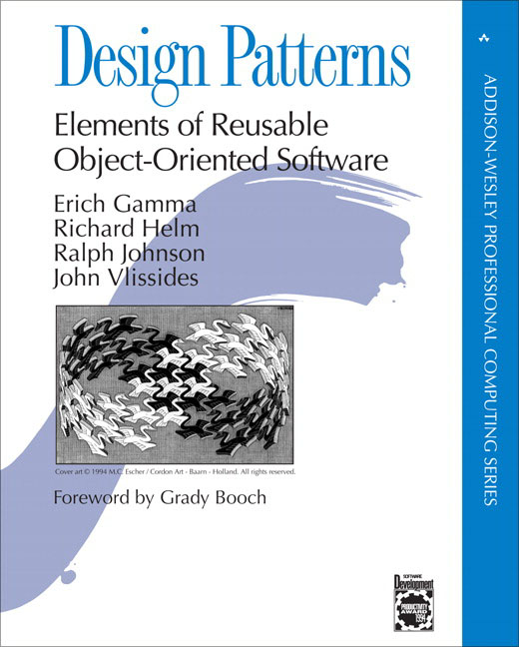
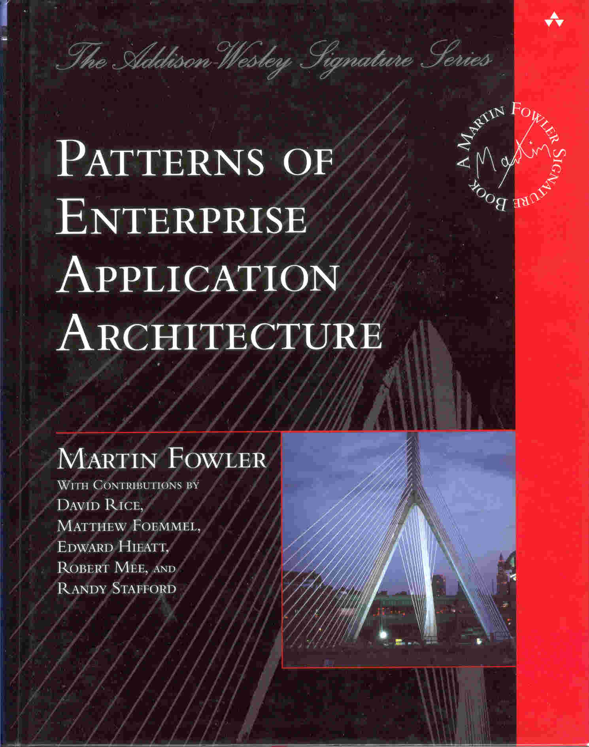
EIP
The legacy
Patterns are not invented!
Patterns are not law, only help
Notes:
Legacy
The good old book on architecture by Christopher Alexander ”A Pattern Language” 1977
Several good books: GoF, EAP..

Slide 7
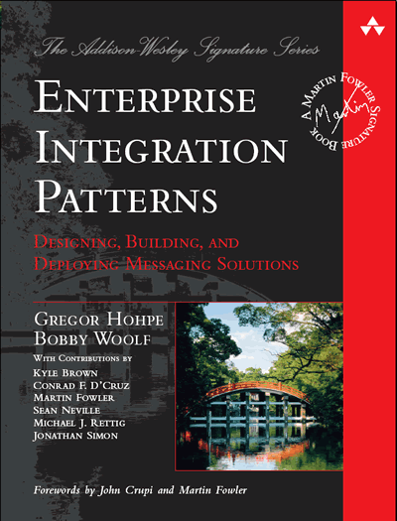
THE CARD DECK
The complete stack
Various types of patterns

Slide 8
EIP CATEGORIES
Integration Styles
Messaging Channels
Message Construction
Message Routing
Message Transformation

Slide 9
INTEGRATION STYLES
File transfer
Shared database
Remote Procedure Invocation
Messaging
Notes:
File transfer:

Slide 10
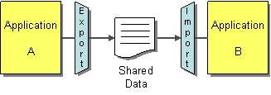
Filetransfer
Files are stored in a common location
Each application is responsible for transformation
Posting and consuming files can be done with any suitable protocol
Common formats include XML, fixed length, symbol separated etc.
Notes:
An enterprise has multiple applications that are being built independently, with different languages and platforms.
How can I integrate multiple applications so that they work together and can exchange information?
Have each application produce files containing information that other applications need to consume.
Integrators take the responsibility of transforming files into different formats.
Produce the files at regular intervals according to the nature of the business.
An important decision with files is what format to use. Very rarely will the output of one application be exactly what's needed for another, so you'll have to do a fair bit of processing of files along the way. Not just do all the applications that use a file have to read it, you also have to be able to use processing tools on it. As a result, standard file formats have grown up over time. Mainframe systems commonly use data feeds based on the file system formats of COBOL. Unix systems use text based files. The modern fashion is to use XML. An industry of readers, writers, and transformation tools has built up around each of these formats.

Slide 11
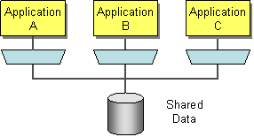
Shared Database
Two or more applications share data in a single database
Applications are always consistent
The database must implement transaction management to handle conflicting updates
One drawback is the ripple effects of database schema changes.
Notes:
An enterprise has multiple applications that are being built independently, with different languages and platforms. The enterprise needs information to be shared rapidly and consistently.
How can I integrate multiple applications so that they work together and can exchange information?
Integrate applications by having them store their data in a single Shared Database.
If a family of integrated applications all rely on the same database, then you can be pretty sure that they are always consistent all of the time. If you do get simultaneous updates to a single piece of data from different sources, then you have transaction management systems that handle that about as gracefully as it ever can be managed. Since the time between updates is so small, any errors are much easier to find and fix.

Slide 12
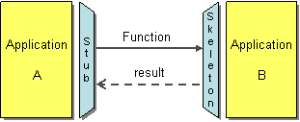
Remote Procedure Invocation
Applications expose interfaces to perform internal actions
Data structure and contents are encapsulated by the application itself
Applications can communicate using a common protocol
CORBA, COM, .NET Remoting, Java RPC
SOAP / XML / json over HTTP
Notes:
An enterprise has multiple applications that are being built independently, with different languages and platforms. The enterprise needs to share data and processes in a responsive way.
How can I integrate multiple applications so that they work together and can exchange information?
Develop each application as a large-scale object or component with encapsulated data.
Provide an interface to allow other applications to interact with the running application.
Remote Procedure Invocation applies the principle of encapsulation to integrating applications. If an application needs some information that is owned by another application, it asks that application directly. If one application needs to modify the data of another, then it does so by making a call to the other application. Each application can maintain the integrity of the data it owns. Furthermore, each application can alter its internal data without having every other application be affected.

Slide 13
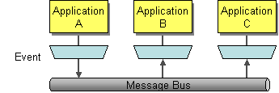
Messaging
Asyncronous messaging removes the dependency that the target system is up and running when sending messages to it.
Guaranteed order of processing
Event messages
Topic, Publish Subscribe
Notes:
An enterprise has multiple applications that are being built independently, with different languages and platforms. The enterprise needs to share data and processes in a responsive way.
How can I integrate multiple applications so that they work together and can exchange information?
Use Messaging to transfer packets of data frequently, immediately, reliably, and asynchronously, using customizable formats.
Asynchronous messaging is fundamentally a pragmatic reaction to the problems of distributed systems. Sending a message does not require both systems to be up and ready at the same time. Furthermore, thinking about the communication in an asynchronous manner forces developers to recognize that working with a remote application is slower, which encourages design of components with high cohesion (lots of work locally) and low adhesion (selective work remotely).

Slide 14
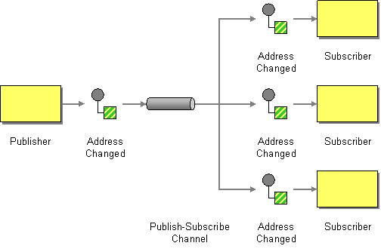
PUBLISH / SUBSCRIBE
One input
n number of subscribers
Each subscriber can consume each message exactly once.
Notes:
How can the sender broadcast an event to all interested receivers?
Send the event on a Publish-Subscribe Channel, which delivers a copy of a particular event to each receiver.
A Publish-Subscribe Channel works like this: It has one input channel that splits into multiple output channels, one for each subscriber. When an event is published into the channel, the Publish-Subscribe Channel delivers a copy of the message to each of the output channels. Each output channel has only one subscriber, which is only allowed to consume a message once. In this way, each subscriber only gets the message once and consumed copies disappear from their channels.

Slide 15
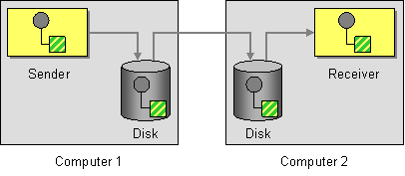
GUARANTEED DELIVERY
Reliability
One ”step” at a time
i.e. For payment transactions.
Notes:
How can the sender make sure that a message will be delivered, even if the messaging system fails?
Use Guaranteed Delivery to make messages persistent so that they are not lost even if the messaging system crashes.
With Guaranteed Delivery, the messaging system uses a built-in data store to persist messages. Each computer the messaging system is installed on has its own data store so that the messages can be stored locally. When the sender sends a message, the send operation does not complete successfully until the message is safely stored in the sender’s data store. Subsequently, the message is not deleted from one data store until it is successfully forwarded to and stored in the next data store. In this way, once the sender successfully sends the message, it is always stored on disk on at least one computer until is successfully delivered to and acknowledged by the receiver.

Slide 16
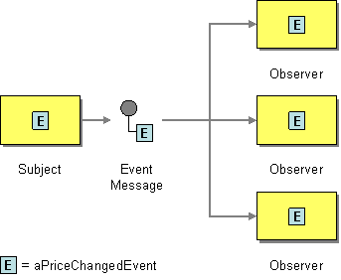
EVENT MESSAGE
Effective way of implementing event driven scenarios
Can be implemented using a Topic
Can be used for: BAM, Monitoring and analysis.
Notes:
How can messaging be used to transmit events from one application to another?
Use an Event Message for reliable, asynchronous event notification between applications.
When a subject has an event to announce, it will create an event object, wrap it in a message, and send it on a channel. The observer will receive the event message, get the event, and process it. Messaging does not change the event notification, just makes sure that the notification gets to the observer.

Slide 17
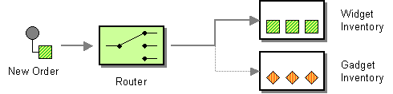
CONTENT BASED ROUTER
Route messages based on message payload
Classic example: ordering system
Notes:
Assume that we are building an order processing system. When an incoming order is received, we first validate the order and then verify that the ordered item is available in the warehouse. This function is performed by the inventory system. This sequence of processing steps is a perfect candidate for the Pipes and Filters style. We create two filters, one for the validation step and one for the inventory system, and route the incoming messages through both filters. However, in many enterprise integration scenarios more than one inventory system exists with each system being able to handle only specific items.
How do we handle a situation where the implementation of a single logical function (e.g., inventory check) is spread across multiple physical systems?
Use a Content-Based Router to route each message to the correct recipient based on message content.
The Content-Based Router examines the message content and routes the message onto a different channel based on data contained in the message. The routing can be based on a number of criteria such as existence of fields, specific field values etc. When implementing a Content-Based Router, special caution should be taken to make the routing function easy to maintain as the router can become a point of frequent maintenance. In more sophisticated integration scenarios, the Content-Based Router can take on the form of a configurable rules engine that computes the destination channel based on a set of configurable rules.

Slide 18
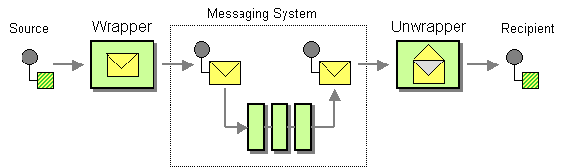
ENVELOPE WRAPPER
When the messaging system shall not/cannot process message payload
Caters for ”dynamic” message content
Notes:
Most messaging systems divide the message data into a header and a body. The header contains fields that are used by the messaging infrastructure to manage the flow of messages. However, most endpoint systems that participate in the integration solution generally are not aware of these extra data elements. In some cases, systems may even consider these fields as erroneous because they do not match the message format used by the application. On the other hand, the messaging components that route the messages between the applications may require the header fields and would consider a message invalid if it does not contain the proper header fields.
How can existing systems participate in a messaging exchange that places specific requirements on the message format, such as message header fields or encryption?
Use a Envelope Wrapper to wrap application data inside an envelope that is compliant with the messaging infrastructure. Unwrap the message when it arrives at the destination.
The process of wrapping and unwrapping a message consists of five steps:

Slide 19
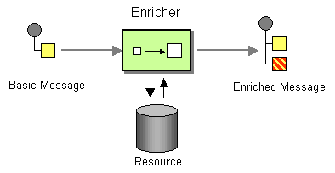
CONTENT ENRICHER
Starts with partial data
Sender has incomplete data
The enricher completes the data using other services(applications and databases (human tasks))
One example is a ”credit application”
Initial personal ID is enriched using i.e. UC to enrich personal data.
Notes:
When sending messages from one system to another it is common for the target system to require more information than the source system can provide. For example, incomingAddress messages may just contain the ZIP code because the designers felt that storing a redundant state code would be superfluous. Likely, another system is going to want to specify both a state code and a ZIP code field. Yet another system may not actually use state codes, but spell the state name out because it uses free-form addresses in order to support international addresses. Likewise, one system may provide us with a customer ID, but the receiving system actually requires the customer name and address. An order message sent by the order management system may just contain an order number, but we need to find the customer ID associated with that order, so we can pass it to the customer management system. The scenarios are plentiful.
How do we communicate with another system if the message originator does not have all the required data items available?
Use a specialized transformer, a Content Enricher, to access an external data source in order to augment a message with missing information.
The Content Enricher uses information inside the incoming message (e.g. key fields) to retrieve data from an external source. After the Content Enricher retrieves the required data from the resource, it appends the data to the message. The original information from the incoming message may be carried over into the resulting message or may no longer be needed, depending on the specific needs of the receiving application.

Slide 20
SUGGESTED READING
Gregor Hohpe’s site on EIP (and book)
http://www.enterpriseintegrationpatterns.com/

Slide 21
THE END
EIP – A BRIEF INTRODUCTION

Slide 22
ICC
Integration Competency Center

Slide 23
LIFE CYCLE MANAGEMENT
SDLCm
REQUIREMENTS
DEVELOPMENT
VERIFY
RELEASE
DEPLOY
Integration/API LCm
PROCESSES
ARCHITECTURE
INTEGRATION LIFE CYCLE
GOVERNANCE

Slide 24
SDLCm
REQUIREMENTS & BACKLOG(GROOMING?)
CI
Building/Testing/Releasing
[INCLUDES INFRASTRUCTURE]
CD
Deploying and Distribution

Slide 26
INTEGRATION / API LCm
ARCHITECTURE
Centralized control over the architecture
Structural Capital
INTEGRATION LIFE CYCLE
PUBLISH
CHANGE
RETIRE
GOVERNANCE
Keep track & be in control

Slide 27
THE END
ICC – Integration Competency Center

Slide 28
ActiveMQ
INTRODUCTION

Slide 29
ACTIVE-MQ
MessageBroker
Light weight
Using a file based storage: KahaDB (default)
Optimized for fast persistence
Configure storage location
Useful web GUI out of the box.
Queues are created as you go!
(i.e. in Camel: from(”activemq:queue:queueName”) will create ’queueName’ automatically in the broker)

Slide 30
Messaging Protocols
OpenWire (default)
Cross platform protocol
Native communication with ActiveMQ from many languages.
STOMP
“The Simple Text Oriented Messaging Protocol”
Typically (not limited to): Ruby, Perl, Python or PHP
AMQP
AMQP 1.0 protocol (which is an OASIS standard)
Small foot-print
MQTT
M2M publish/subscribe, very lightweight protocol
IoT, typically used when small client foot-print is required
Other
http://activemq.apache.org/connectivity.html

Slide 31
STORAGE OPTIONS
KahaDB (default and recomended)
http://activemq.apache.org/kahadb.html
File based
Tuned for performance
JDBC
A number of database implementations supported ”out-of-the-box”

Slide 32
THE END
ActiveMQ - INTRODUCTION

Slide 33
LAB #1
GETTING STARTED

Slide 34
LAB Instruction
See: https://github.com/r2m/hig-kurs/blob/master/activemq/README_lab1.md

Slide 35
LAB #2
SENDING MESSAGES TO A QUEUE

Slide 36
LAB Instructions
See: https://github.com/r2m/hig-kurs/blob/master/activemq/README_lab2.md

